Slide 1



TOPIC: Digital Payment Awareness
COURSE: CCC Concepts
DAY: 43
Presented By: Anjali Dhingan

Slide 2
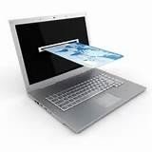

Safety Precautions
DIGITAL FINANCIAL SERVICES

Slide 3
Safe and Secure Banking Tips
Always use genuine anti-virus software
Avoid using public Wi-Fi or Use VPN Software
Check for latest updates of Operating System
Change your password regularly and ensure that it’s a strong one
Don’t use public computers to login to net banking
Be Aware of skimming (where fraudsters install a device on top of card reader in ATM machine

Slide 4
Safe and Secure Banking Tips
Always check the last log-in date and time, in the post login page
Never store User-id and Password in written somewhere
Avoid Signing-in to your net banking account via phishing mailers
Don’t share your OTP through call or email
Use only the official bank app provided by Google play store
Ensure correct URL https:\ and any other tracking cookies

Slide 5
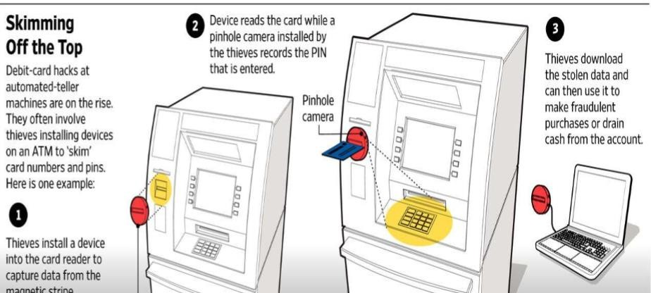
Skimming

Slide 6
Phishing
Phishing is the attempt to obtain sensitive information such as usernames, passwords, and credit/debit card details (and money), often
for malicious
reasons, entity
by disguising as a in an
trustworthy communication
electronic

Slide 7
Using Botnets
Botnets are computers infected by worms or Trojans and taken over surreptitiously (secretly) by hackers and brought into networks to send spam, more viruses, or launch denial of service attacks
Remotely controlled by the attacker.
SQL Injection attacks

Slide 8
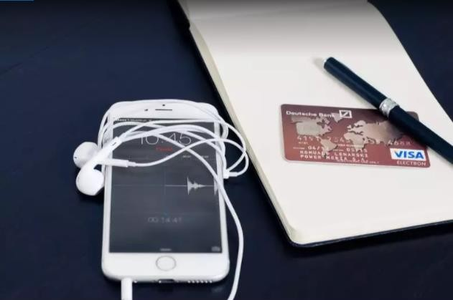
Keyloggers
A keylogger (short for keystroke logger) is software that tracks or logs the keys struck on your keyboard, typically in a covert manner so that you don't know that your actions are being monitored
Modified to extract personal information
Keyloggers are designed to monitor all the key strokes

Slide 9
Few Useful Tips
Use a power-on/access password for your computer, laptop and mobile as well as a screensaver password so that no one else can access your systems without consent
Change your passwords and security settings regularly
Always visit your bank’s secure Internet Banking site directly
Avoid accessing the site through a third-party link or via email
Verify the domain name before you try to log in

Slide 10
Few Useful Tips
Log out of your Internet Banking account the minute you complete transactions; Do not close the window without logging off
Avoid using Internet Banking on unsecured Wi-Fi networks such as railway stations, airports and cybercafés
Install authentic security programmes to guard your system and
account against hackers, virus attacks and other malware
Update the security programme or antivirus regularly

Slide 11
Few Useful Tips
Install a suitable firewall to protect your computer or laptop and its contents
Never provide remote access to your system to anyone; not even family members, as it is still vulnerable to hacking
Disable the ‘File and Printing Sharing’ command on the operating system
Always log off your PC or laptop when not in use; don’t keep it lying around or trust a stranger with it

Slide 12
Few Useful Tips
Never save your mobile banking log-in and password
phone; memorize it
on the
Never leave your handset unattended and logged into a mobile banking app
Always lock your phone to prevent unauthorized use
Notify your bank as soon as your mobile is lost or stolen
Update the mobile banking app as and when version/upgrade is released
a new

Slide 13
Few Useful Tips
Update your phone with latest security patches
Never download apps from untrustworthy and dubious sources
Always log out of your banking app after using it
Keep an eye on your account balance and transaction history regularly
If you suspect unauthorized transactions on your account, report it to your bank immediately

Slide 14
Thank you!
www.nielit.gov.in/haridwar

